Slide 1
Woodland Public Schools
Facilities and Safety
December 2016 report

Slide 2
FACILITIES REPORT
Locks WPS/WMS
Final installation of the interior door locks are in progress at WPS and WMS. This alteration will allow teachers and staff members to quickly lock school room doors in the event of a Lockdown situation. Currently, teachers need to find their keys, go outside the room, lock the door from the outside, then proceed back into the room. This installation should be complete by Mid-February.
WIS Portables – The purchase order for the portables will be issued the week of 1/16 to KCDA (Modern Building Systems) for two 2014 portables that were installed at the Federal Way High school during their school remodel. These units are in pristine condition, with the only item showing any wear being the carpeting. Modern is providing a $6400 credit for carpet replacement. Buying the used portables saves approximately $22k per building. Additional savings are also recognized, due to the units being equipped with interior and exterior accessories, such as white boards, storage lockers, rain gutters, etc. The portables are currently planned to be placed to the South of the main building, which will allow students good access to all school areas, specifically the gym, lunchroom library, school office and playground.
Card Key Access System – A PO was issued to Tyco Integrated Security for card key access for WPS, WMS and WIS. An implementation meeting is scheduled for the week of 1/16, to lay out the project schedule moving forward. Hardware and software has been ordered with a 6-8 week lead time.

Slide 3
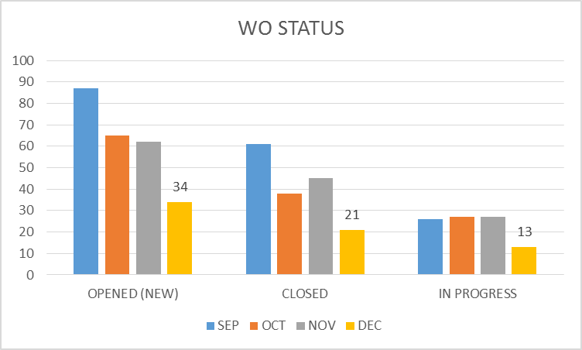
FACILITY CHARTS – POWER COST AND WORK ORDER STATUS

Slide 4
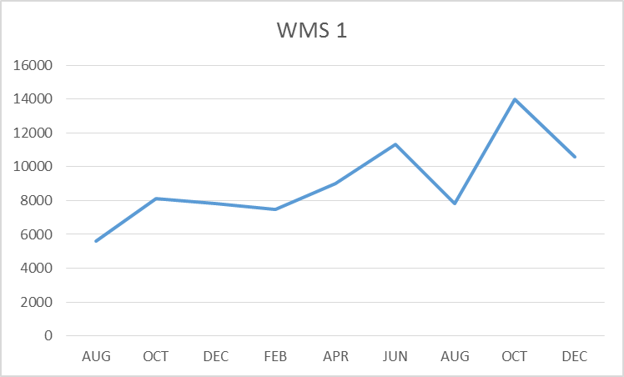
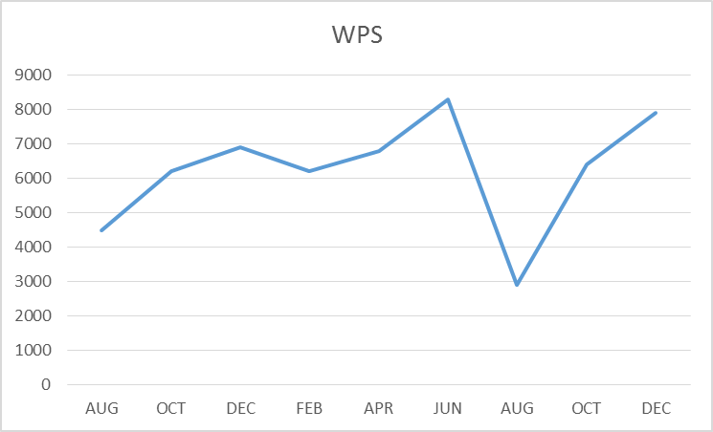
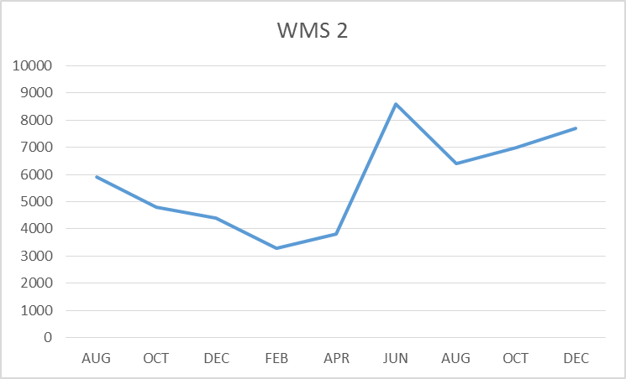
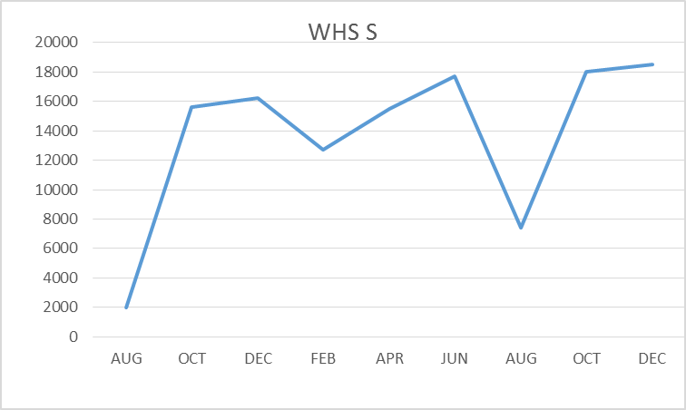
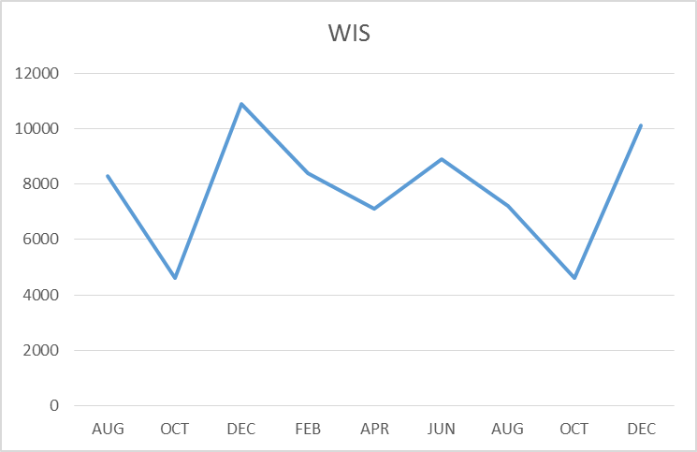
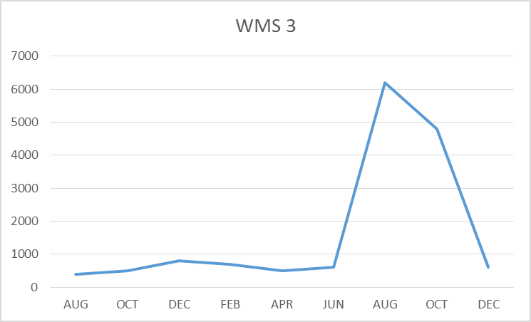
FACILITY CHARTS – WATER USAGE- WHS, WIS, WMS, WPS

Slide 5
SAFETY
Accidents for the month
There were a total of 10 injuries in the month of December-3 students and 8 staff members.
Staff Accidents/Incidents (7)
WPS – Staff slipped on grape in lunchroom.
WPS – Student kicked IA multiple times (3 events).
WPS – Student threw book at IA.
WPS – Student punched IA multiple times (2 Events).
Student Accidents/injuries (3)
WPS – Student fractured ankle after jumping in air.
WPS – Student bumped head while sliding on gym floor into wall .
WHS – Student fractured leg during JV basketball game

Slide 6
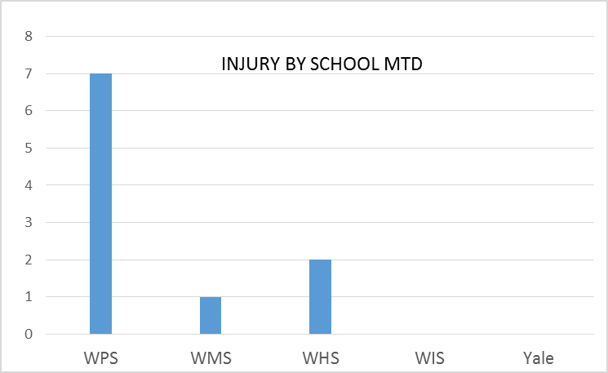
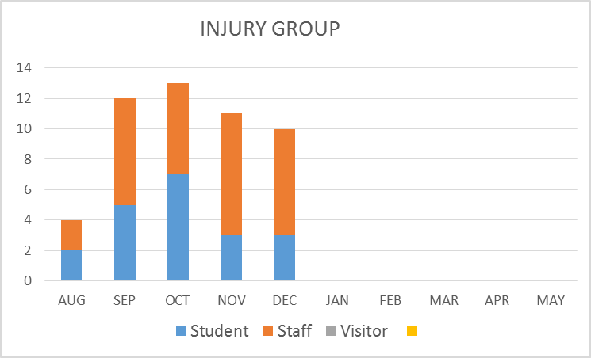
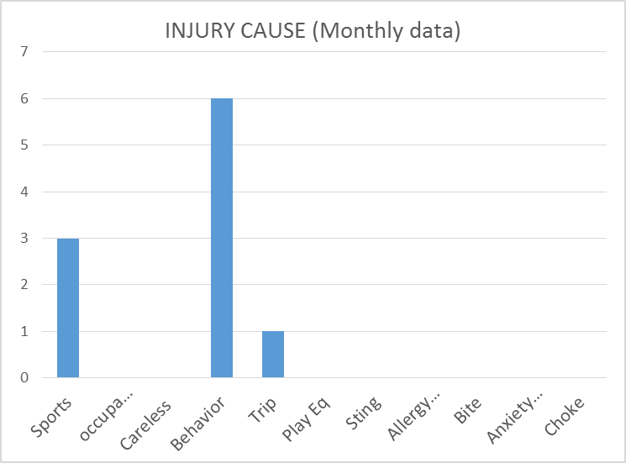
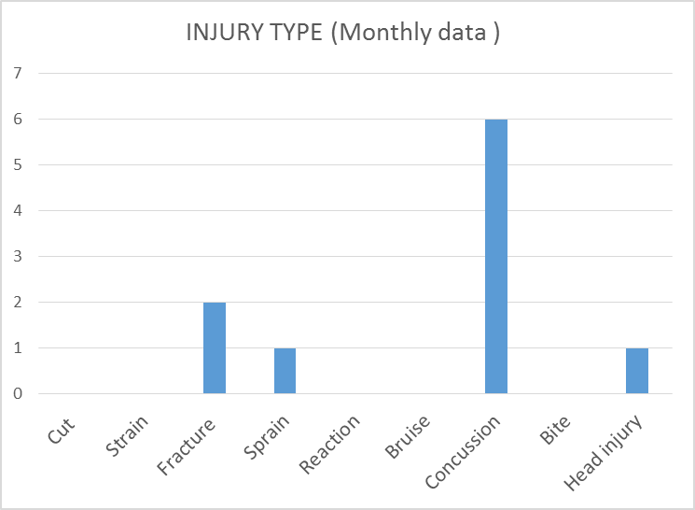
SAFETY CHARTS

